Slide 1

Neural Networks 1:
Foundations
Nicholas Beaudoin | beaudoin@caltech.edu

Slide 2
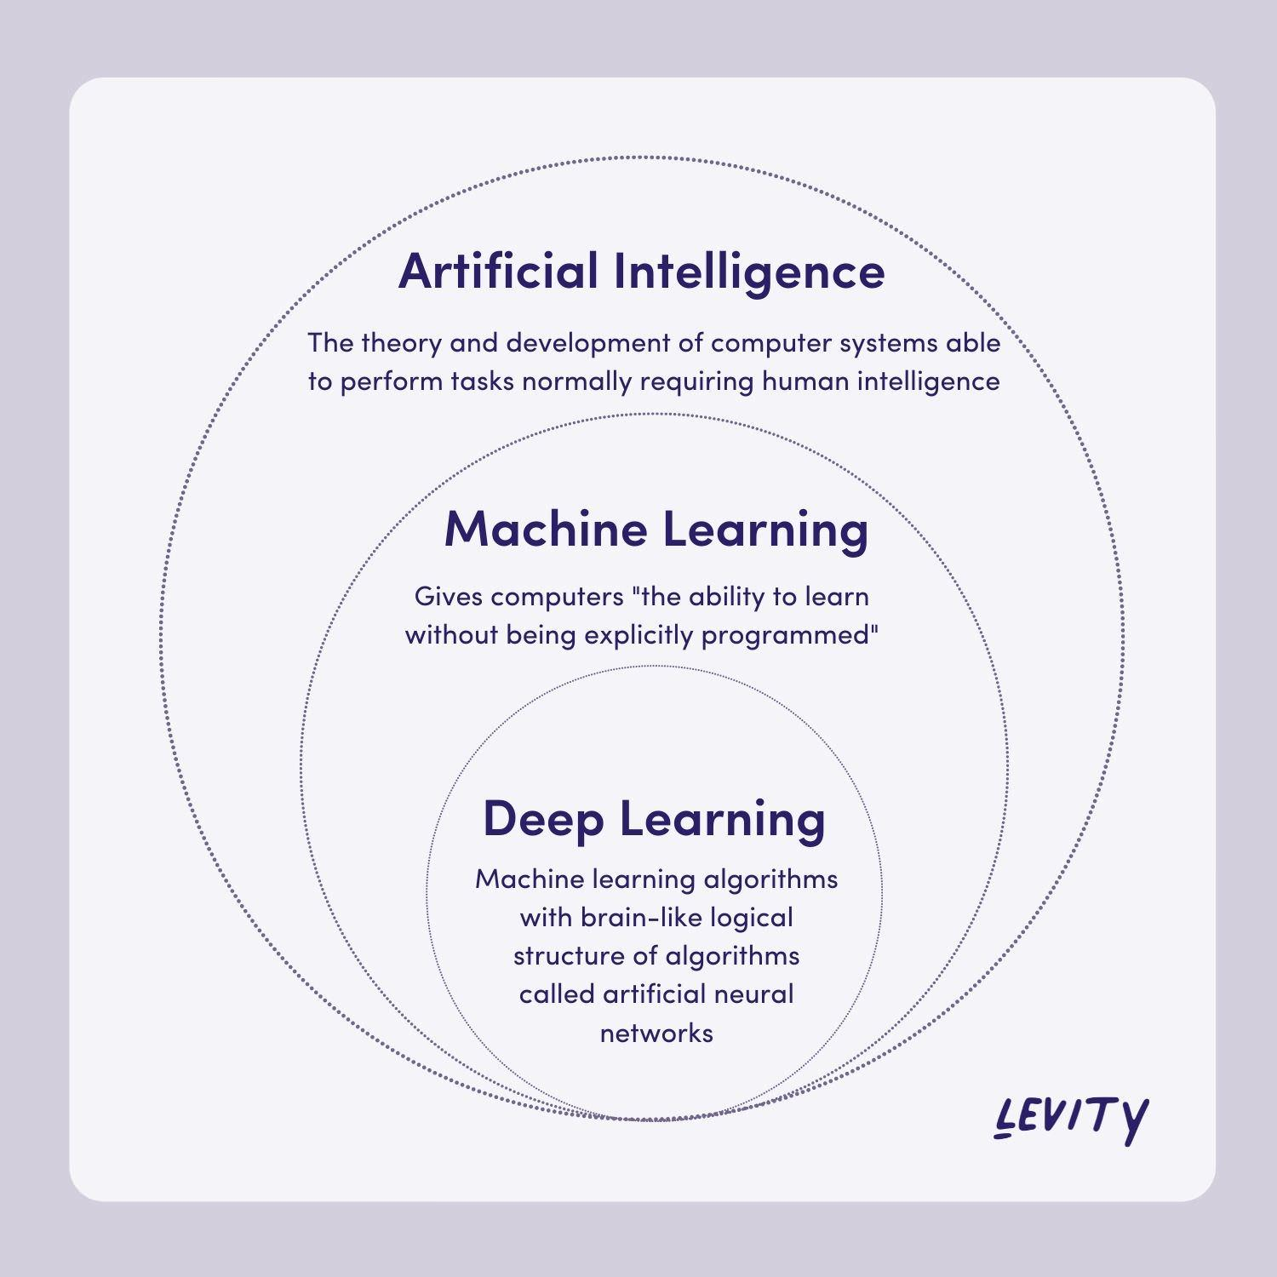
We know this story
Source: levity.ai

Slide 3
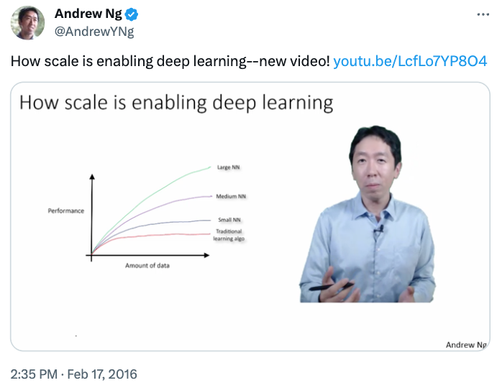
Source: Andrew Ng

Slide 4
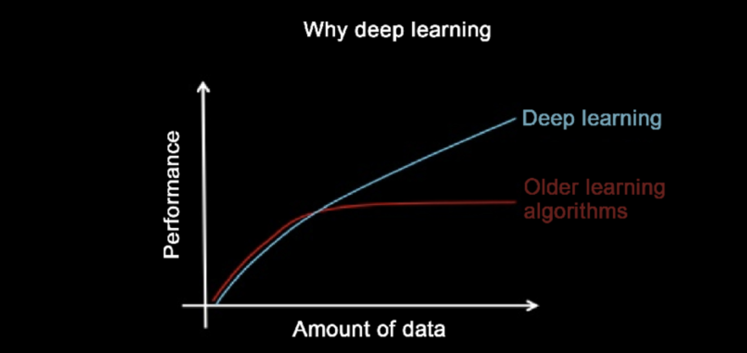
Neural networks scale…. really well…
Source: Andrew Ng

Slide 5
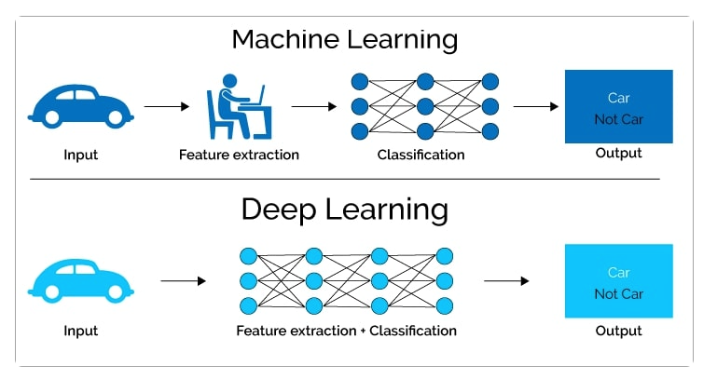
Popular portrayal
Source: levity.ai

Slide 6

But not as easy as first glance
Source: xkcd

Slide 7
Issues with Feature Engineering
Feature definitions not the same across different teams
Time spent doing the same feature extractions over and over again
Features used for training might not be the same at the time of inference (prediction)
Features change over time, known as feature drift
Concept drift: Target variables changes over time
Data drift: Input variables change of time
Batch, on-demand and streaming data all have different requirements for transforming, storing and serving
Source: https://neptune.ai/blog/feature-stores-components-of-a-data-science-factory-guide

Slide 8

Machine Learning: Recap
Big idea: Define a program that acquires the input/output relationship from data
Key idea: it would be easier to provide data or examples than to explicitly define the rules if they are complex and have many special cases & exceptions, i.e. choice of parameterization
Question: Does this also apply to learning of living beings?
program
[object class]

Slide 9
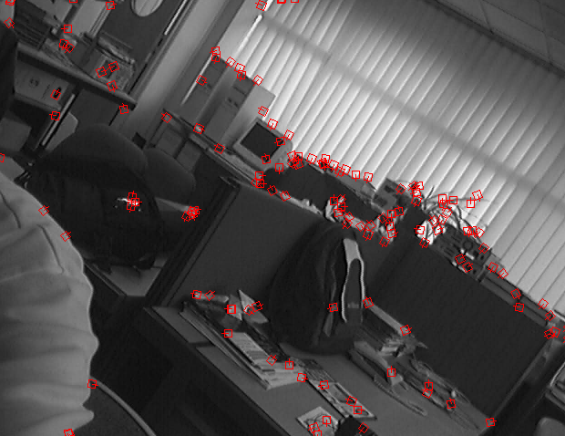
Shallow vs. Deep Learning
[object class]
[object class]
fixed function for feature extraction :
Not quite there: still hand-crafting features
Learning on top of features can be simple
But good features are hard to design

Slide 10
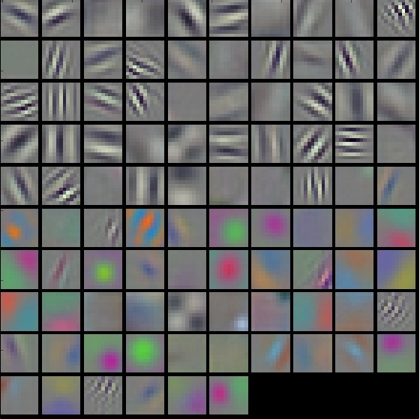
Shallow vs. Deep Learning
Shallow vs. deep learning
[object class]
input
features
Learn this too?
Learned features
Contains all parameters
Notes:
Can we learn what the features are themselves?

Slide 11
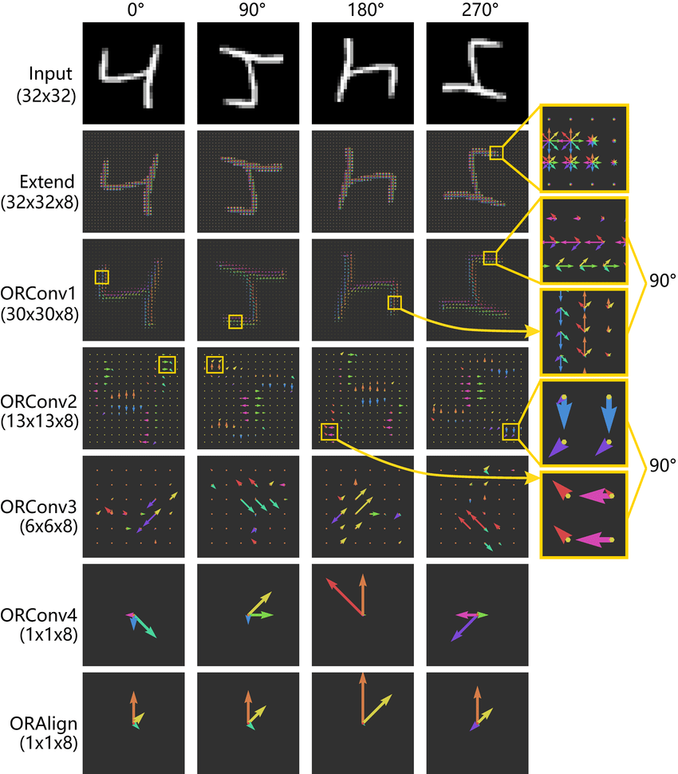
Multi-layered representations
Deep learning: multi-layered representations
Each layer is a parameterized transformation of the preceding layer
Higher level features are
More abstract
More invariant to disturbances (noise)
Easier to use

Slide 12
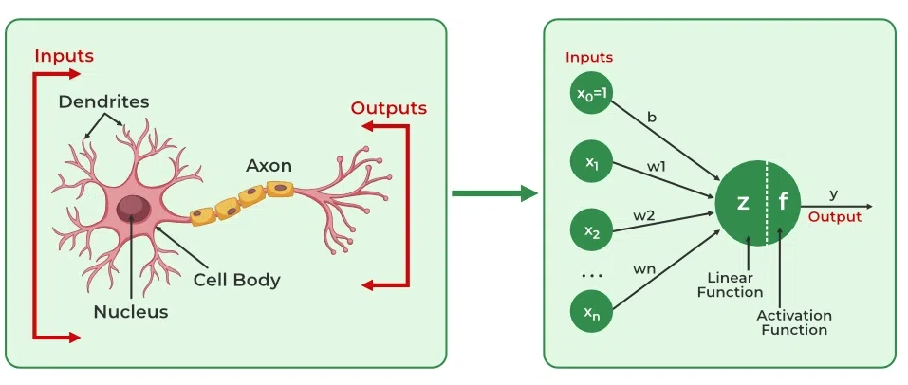
Biological inspirations
Source: https://www.geeksforgeeks.org/artificial-neural-networks-and-its-applications/

Slide 13
High-level
Machine learning with multiple learned-representation layers
Function that represents this transformation is usually a deep neural network
Parameters for each layer are usually trained w.r.t. the designed task
End-to-end learning

Slide 14
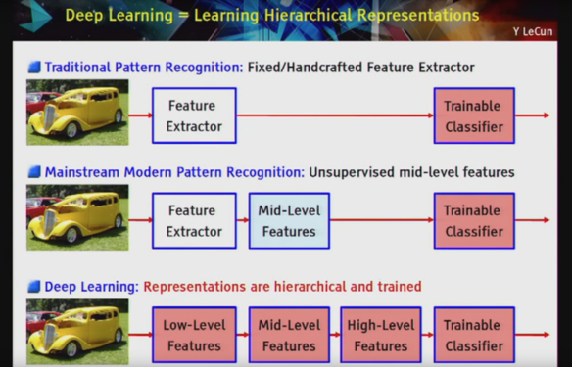
Source: https://www.youtube.com/watch?v=Qk4SqF9FT-M

Slide 15
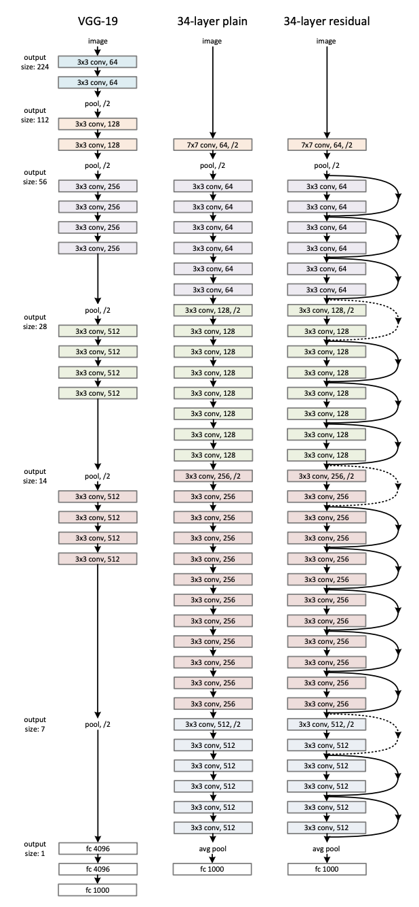

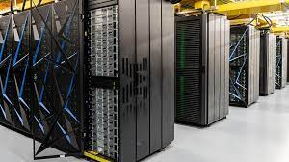
What makes it work?
Big models with many layers
Large datasets with many examples
Sufficient compute to train in tractable time

Slide 16
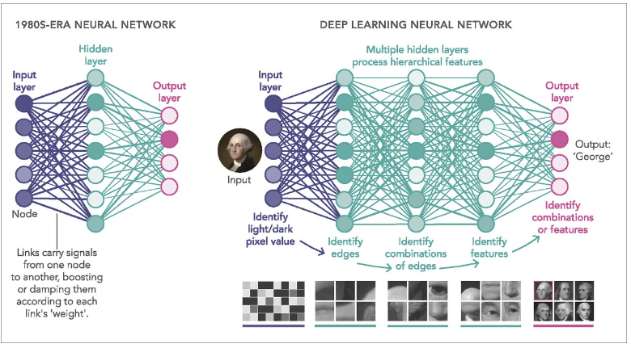
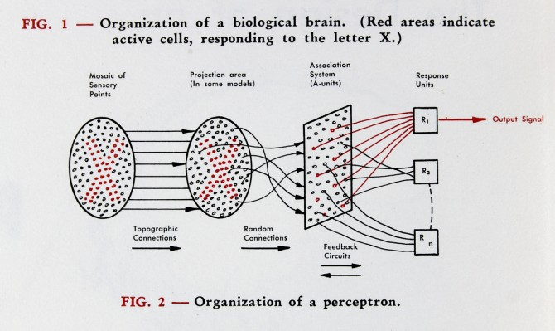
This is not new
Late 1950s
Source: https://www.pnas.org/doi/10.1073/pnas.1821594116
Notes:
Per wikipedia: “The first hardware implementation was Mark I Perceptron machine built in 1957 at the Cornell Aeronautical Laboratory by Frank Rosenblatt, funded by the Information Systems Branch of the United States Office of Naval Research and the Rome Air Development Center. It was first publicly demonstrated on 23 June 1960.”

Slide 17
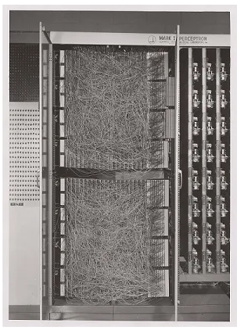
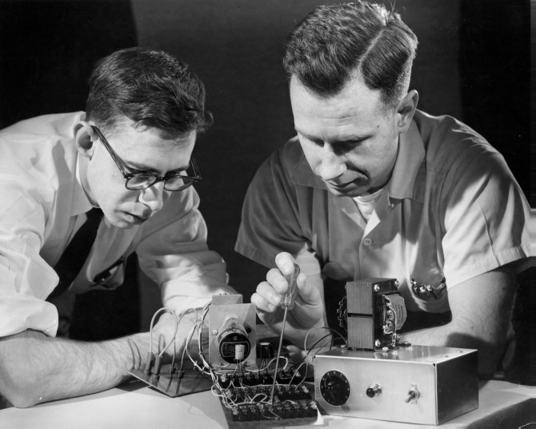
The perceptron begins (1950s)
Mark 1 Perceptron
Source: Cornell
Notes:
Frank Rosenblatt, left, and Charles W. Wightman work on part of the unit that became the first perceptron in December 1958.
It is known that finding the right weights and biases is essential to trianing a neural net, but there was no means to do this.
Until the 1980s, backpropagation was leveraged, with stochastic gradient descent, to unlock it.

Slide 18
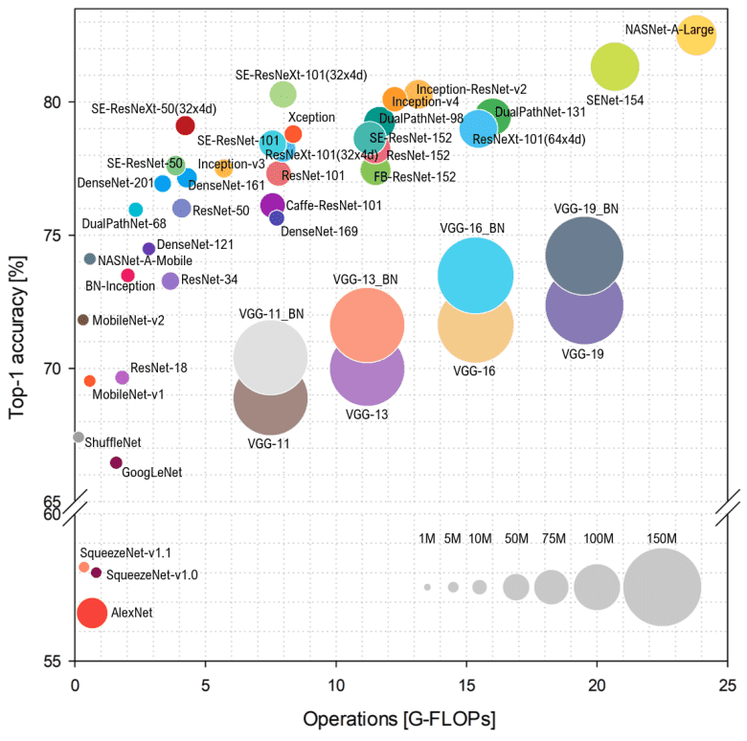
Drivers
GPUs
Parallelization
Open-source community
Notes:
NVIDIA A100

Slide 19
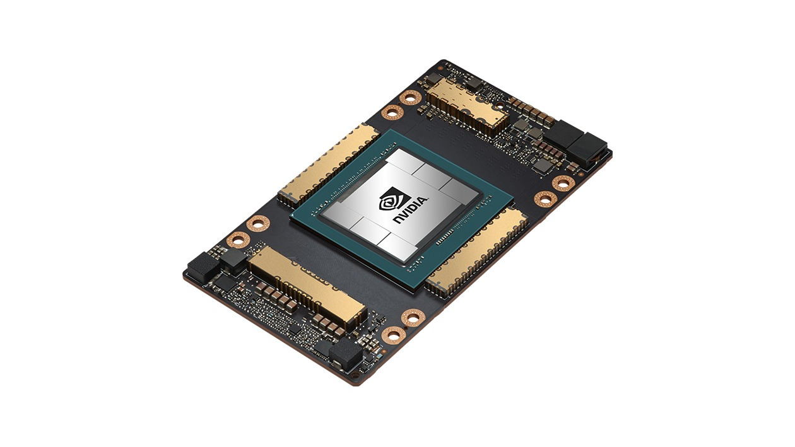
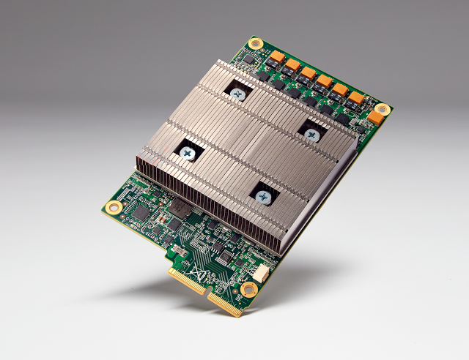
CPUs to GPUs (and TPUs)
A100
NVIDIA’s A100/H100
Google’s TPU
Source: Forbes
Notes:
TPUs optimized for TensorFlow
Energy efficient? (Google claim)

Slide 20
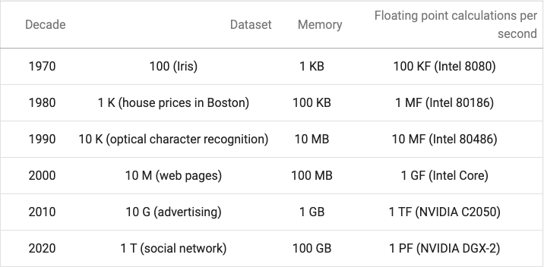
Why now?
Source: 2dl.ai

Slide 21
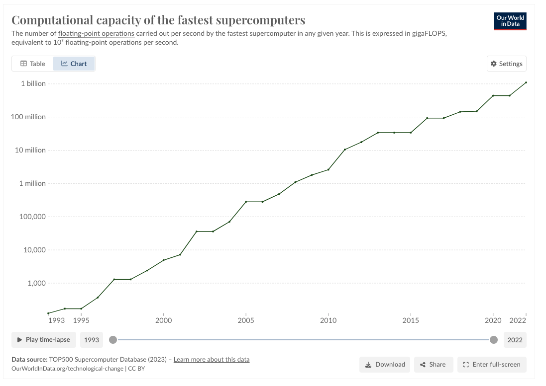
Notes:
FLOP capacity is a logarithmic scale
Moore’s Law: Transistors on chips double every two years, while cost is halved

Slide 22
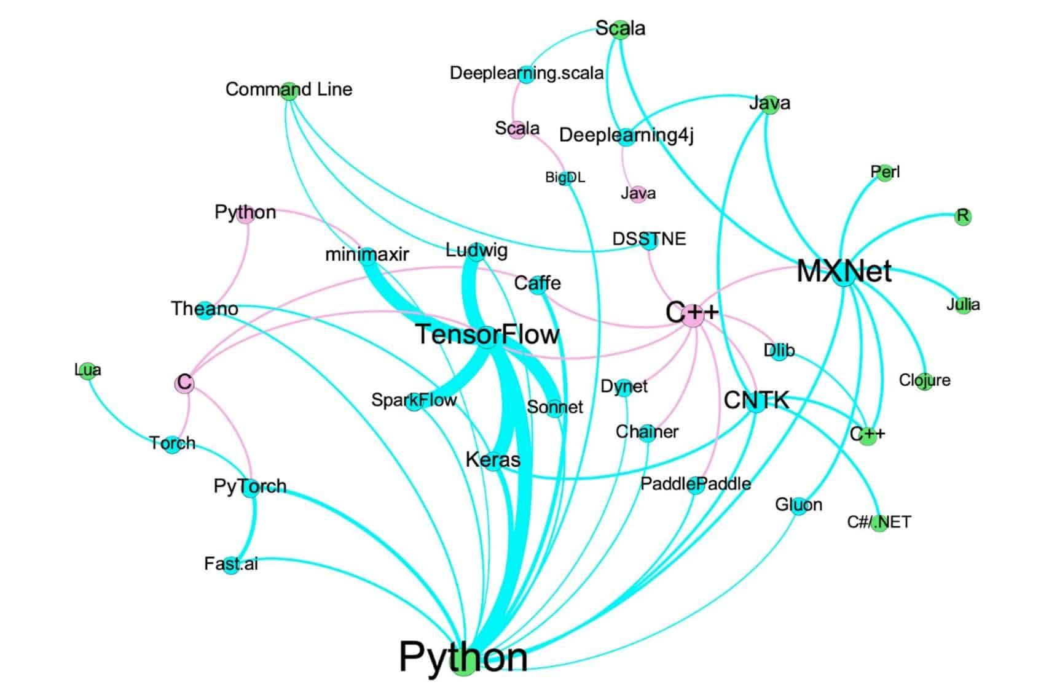



Deep Learning Tools
Source: https://www.rtinsights.com/top-deep-learning-tools/://www.rtinsights.com/top-deep-learning-tools/rnell
Notes:
Older article
Missing JAX: NumPy for Deep Learning - “NumPy Accelerator”
More flexibility in the autograd process (composible functions where we rely on Chain Rule)
Faster than NumPy on CPU
Built on:
Uses JIT (Just in Time compilation) which is faster
Uses XLA: Accelerated Linear ALgebra library

Slide 23
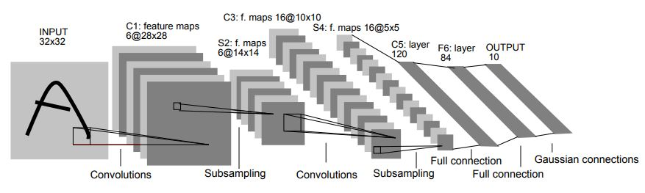
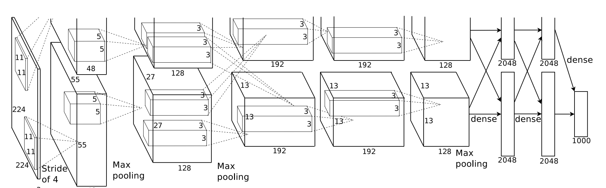
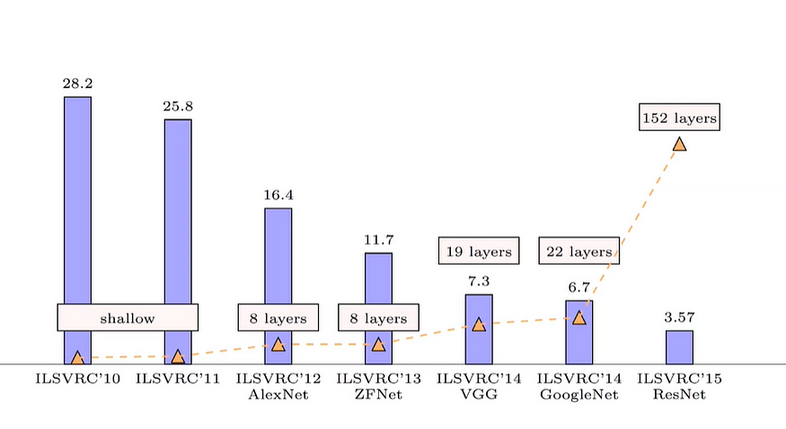
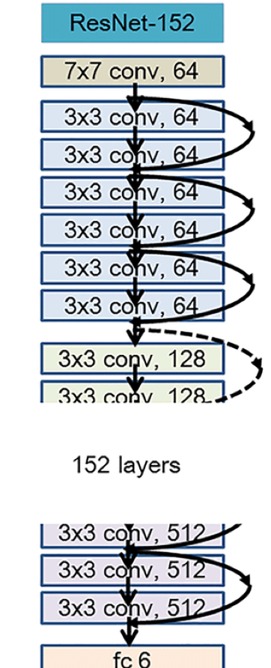
Scale
LeNet, 7 layers (1998)
Model scale: more layers = better?
AlexNet, 8 layers (2012)
ResNet-152: 152 layers (2015)
Notes:
CNN Architectures Evolved from 2010–2015

Slide 24
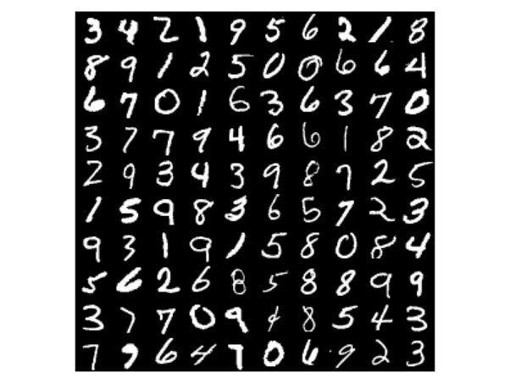
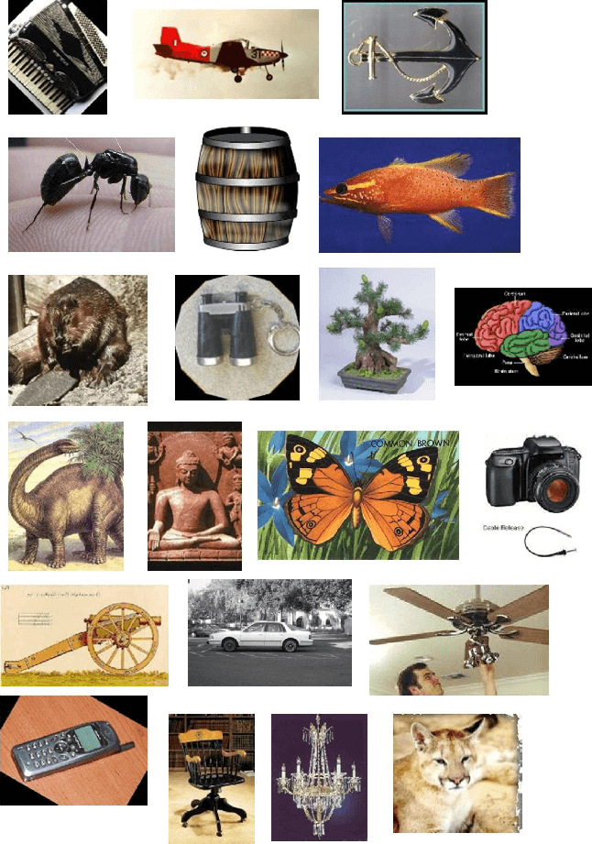
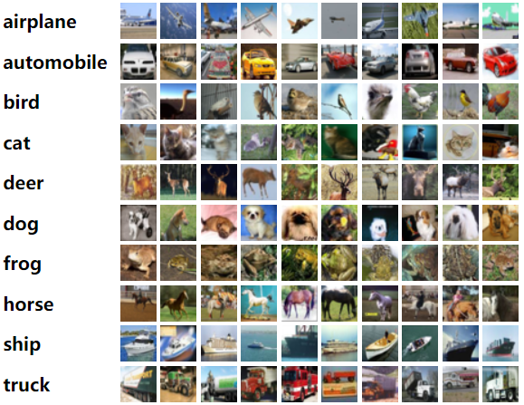
Datasets
MNIST (handwritten characters), 1990s: 60,000 images
CalTech 101, 2003: ~9,000 images
CIFAR 10, 2009: ~60,000 images
ImageNet, 2009: 1.5 million images*
Notes:
Caltech-101 consists of pictures of objects belonging to 101 classes, plus one background clutter class.
https://paperswithcode.com/dataset/caltech-101
ImageNet created by FeiFei Li and her team

Slide 25
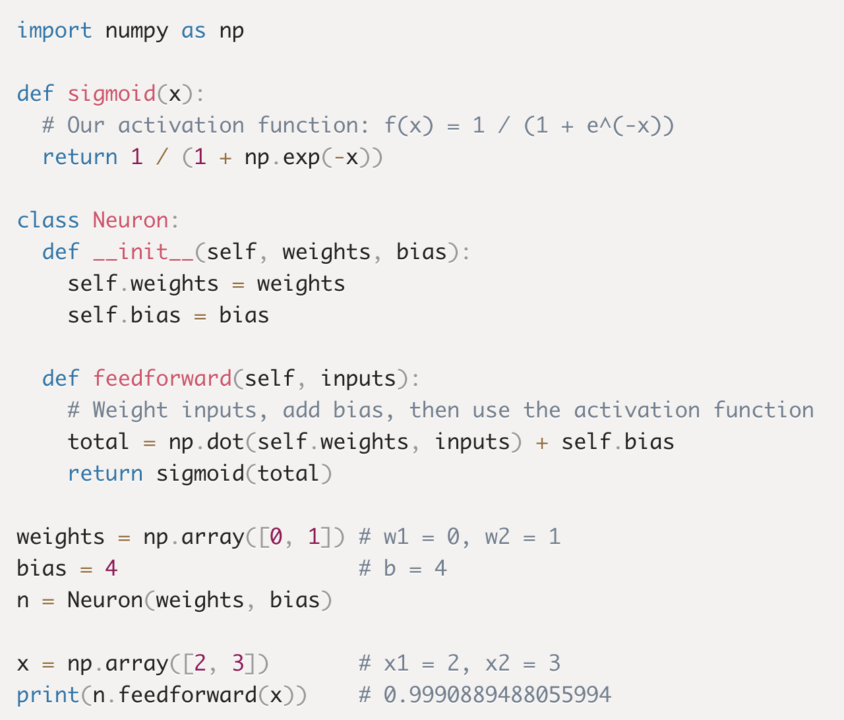
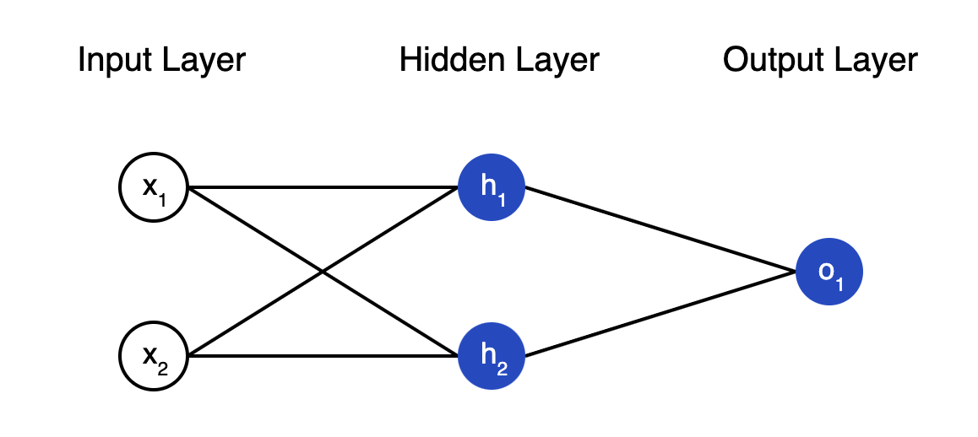

Compute by hand
Notes:
Explain what this code is doing
Bias term shifts the activation function
If the model learns it doesn’t need the bias, then it sets it near 0

Slide 26
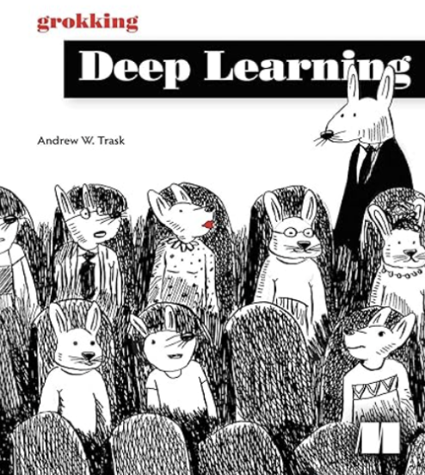
Like doing things “by hand”?
Source: Link to Trask’s book

Slide 27
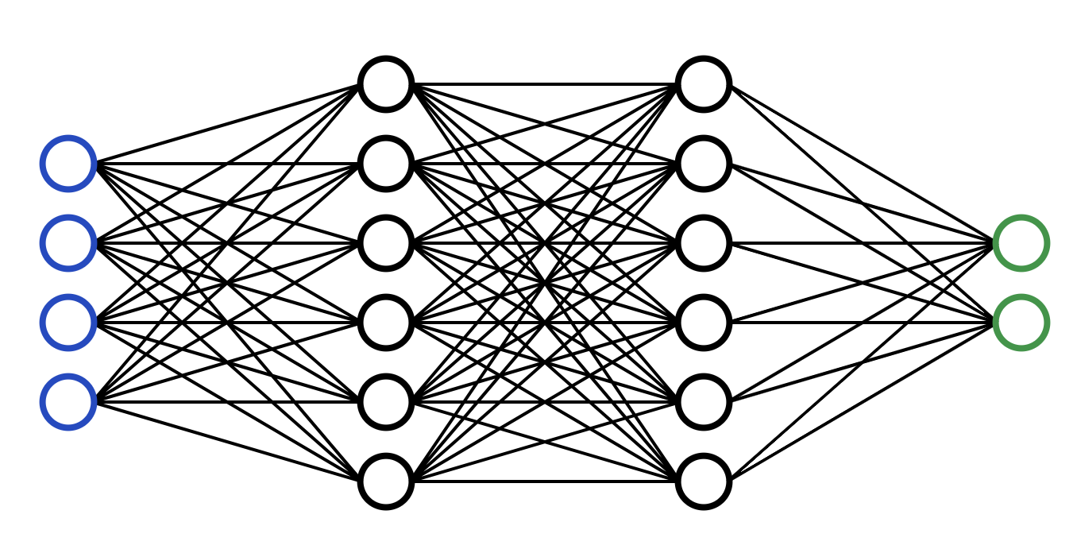
Basic Architecture
Forward pass
2
8
512
512
Notes:
Go through feedforward, backprop, compute cost function via gradient descent, adjust weights/biases, repeat

Slide 28
Basic Architecture
Calculate
errors
Notes:
Go through feedforward, backprop, compute cost function via gradient descent, adjust weights/biases, repeat

Slide 29
Basic Architecture
Backward pass
Notes:
Backpropagation!
Learns what each error contributed

Slide 30
Basic Architecture
Backward pass (aka, “backpropagation”)
Notes:
Backpropagation!
Learns what each error contributed

Slide 31
Basic Architecture
Backward pass (aka, “backpropagation”)
Notes:
Learns what each error contributed

Slide 32
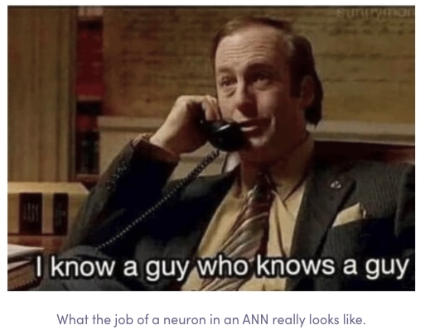
What a Neural Network Really Does
Source: levity.ai

Slide 33
Basic Architecture
Update
weights
Notes:
Gradient Descent based on info learned in back prop

Slide 34

Basic Architecture
REPEAT…
Notes:
Go through feedforward, backprop, compute cost function via gradient descent, adjust weights/biases, repeat

Slide 35
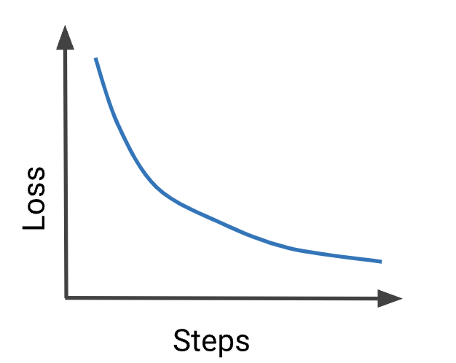
Over Time
Notes:
Stochastic Gradient Descent… where we optimize this loss function and update the proper weights
More to come on this!

Slide 36
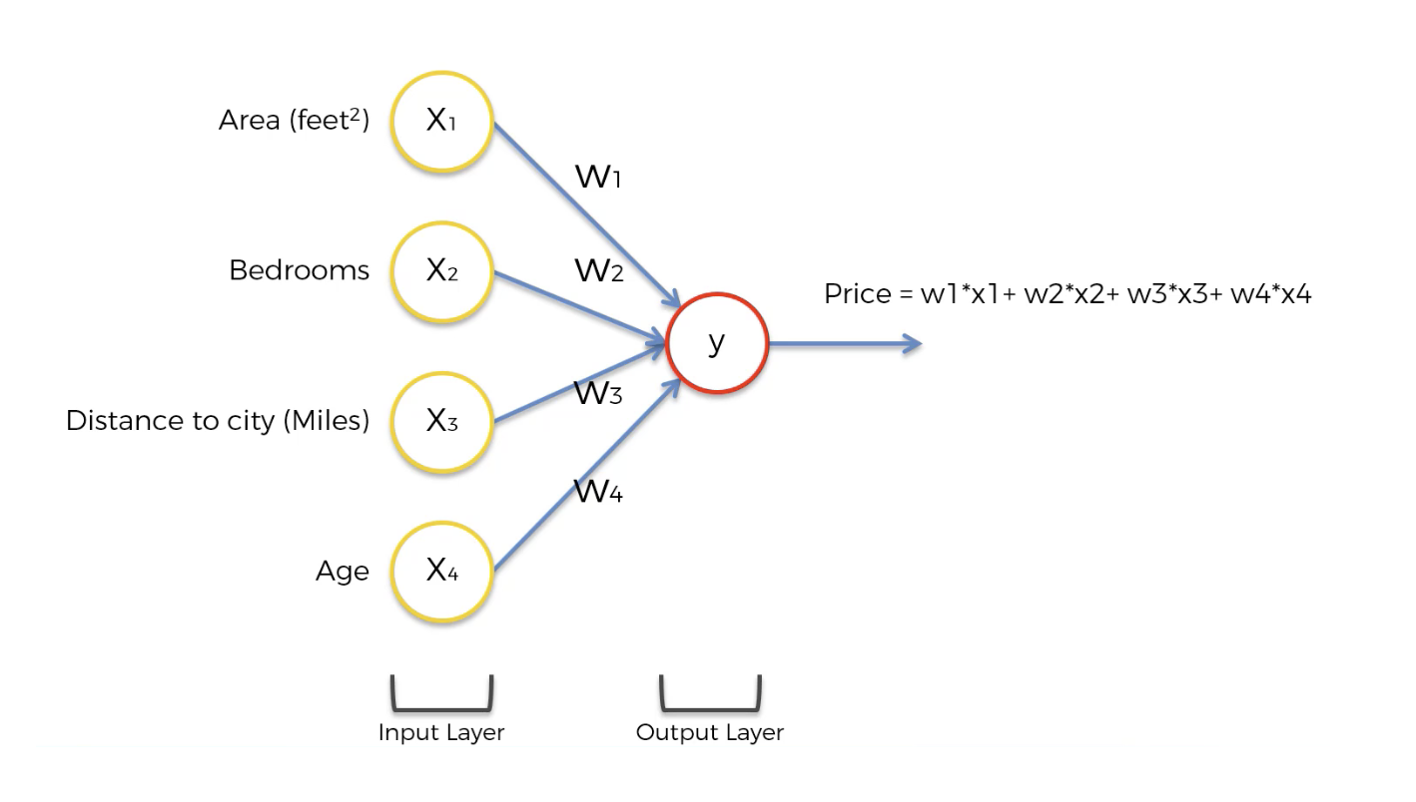
Conceptualizing Features
This looks like linear regression!
Source: https://www.freecodecamp.org/news/deep-learning-neural-networks-explained-in-plain-english/

Slide 37
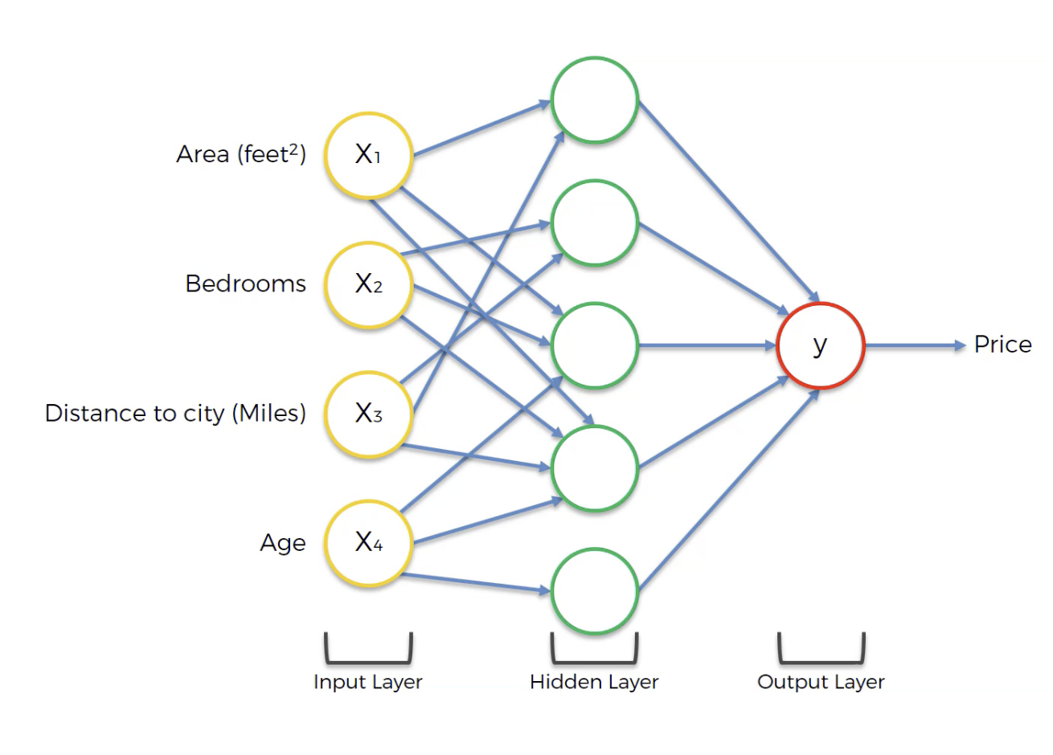

Conceptualizing Features
Hidden layers find new patterns!
Source: https://www.freecodecamp.org/news/deep-learning-neural-networks-explained-in-plain-english/

Slide 38
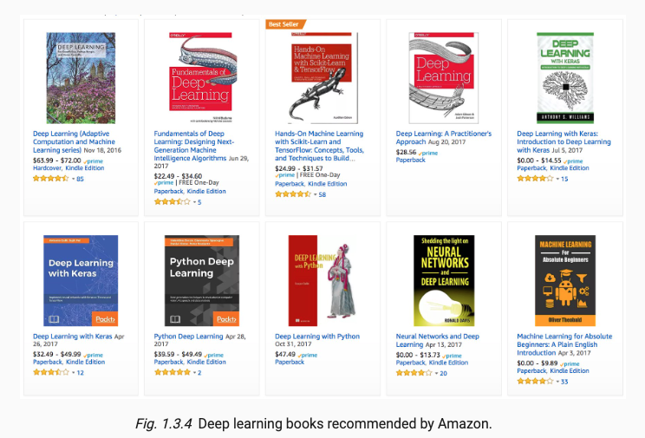
Abundance of Resources
Source: 2dl.ai

Slide 39
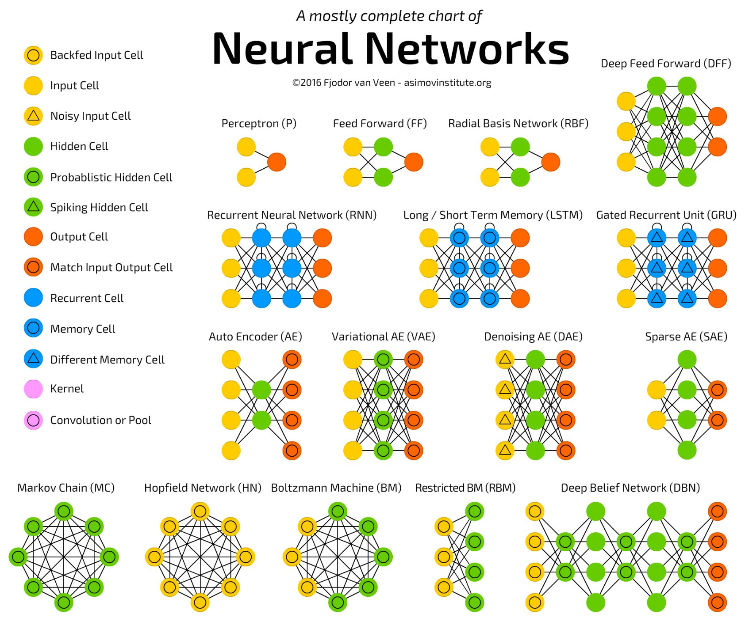
LINK
Source: https://www.asimovinstitute.org/neural-network-zoo/

